Slide 1
Modified Propane Days 2020: Policy Issue Overview
July 2020

Slide 2
Welcome!
Thank you for your interest in participating in Propane Days 2020!
Due to the ongoing COVID-19 pandemic, NPGA has modified it’s annual DC-based advocacy event to a month-long series of in-district engagement opportunities.
We hope you will help NPGA and the propane industry by hosting a Member of Congress at your facility or visiting them at their nearest district office.

Slide 3
New for propane Days 2020
Site Visits
Invite a Member of Congress or their staff to tour your facility to learn more about the industry and see firsthand the important role your business plays in your community.
District Meetings
Schedule a meeting with your Member of Congress at their local district office to discuss your business and propane industry policy priorities.
Propane Days 365
Online toolkit currently available on NPGA’s website that contains resources such as policy one-pagers, a site visit guide, grassroots letters, and other advocacy documents.
https://www.npga.org/propane-days-365/
.

Slide 4
Site Visit Guide
Learn more about site visits and how to prepare for your own with NPGA’s Site Visit Guide. The document is housed on the NPGA member website.

Slide 5
District Meeting Guide
Learn more about district meetings and how to prepare for your own with NPGA’s Site Visit Guide. The document is housed on the NPGA member website.

Slide 6
Meeting Background Top Sheets: Tailored Advocacy
Priority Policy Issues
Based on your legislator’s Committee membership and issue interests, NPGA will assign 2-3 topics for you to discuss during your event.
District Data
Each top sheet will also include general information about the propane industry in your legislator’s district or state.

Slide 7
What are our issues this year?
Enacting a propane-specific exemption from the Jones Act.
Extending Alternative Fuel and Refueling Infrastructure Tax Credits.
Clean Corridors Program
Appropriations
Low Income Home Energy Assistance Program (LIHEAP)

Slide 8
The Jones Act
Designed to protect the domestic shipbuilding and shipping industries, Section 27 of the Merchant Marine Act of 1920 establishes domestic requirements for ships moving goods between U.S. ports
There are currently no Jones Act-compliant propane cargo vessels, which restricts distribution of domestically produced propane
The Ask: Provide a permanent waiver of the Jones Act for LPG to provide efficient supply to critical parts of the United States and ensure domestically produced propane is accessible.

Slide 9
Extend Alternative Fuel Tax Credits
The Alternative Fuel Tax Credit provides a 37 cent per gallon credit on the sale of propane when used in motor vehicles (including forklifts), and the Alternative Fuel Infrastructure Tax Credit provides an income tax credit equal to 30% of the cost of qualified alternative fuel vehicle refueling property through 2020.
The alternative fuel tax credits incentivize alternative fuel use, increase consumers’ buying-power, and create a clean, domestic, and economical alternative to gasoline and diesel.
The Ask: Support a long-term extension (at least 5 years) of the Alternative Fuel Tax Credit, and the Alternative Fuel Refueling Infrastructure Tax Credit.

Slide 10
Include propane in the Clean Corridors Program
The House and Senate have introduced legislation to create grant funding opportunities for refueling and recharging infrastructure along designated corridors of the interstate highway system. Currently, propane is included in H.R. 2 the House Highway Bill. It remains carved out of the Senate Environment and Public Works Committee package, S. 2302.
Grant funding opportunities for refueling infrastructure will help address “range anxiety” for alternative fuel vehicle users and help increase the adoption of important emissions reducing technologies in the transportation sector.
The Ask: Ensure propane is eligible for grant funding opportunities for the installation of alternative fueling infrastructure in the next surface transportation reauthorization package.

Slide 11
Include propane in Federal Appropriations
In 2019, the propane industry received access to $15 million in federal appropriations funding. The United States Department of Energy granted the propane industry along with natural gas to a pot of $10 million for combined heat and power (CHP) systems and $5 million for propane vehicle energy technology development.
NPGA submitted four separate appropriations requests for FY2021, including another request for vehicle engine technology RD&D. The new requests are for federal support of renewable LPG, resilience of the nation’s energy distribution systems and microgrid technology, and micro CHP systems.
The Ask: Please support NPGA’s four Energy & Water appropriations requests. As a clean and abundant domestic fuel source, investment in propane technologies plays a vital role in an all-of-the-above approach to future emissions reductions.

Slide 12
Ensure Liheap has sufficient Funding
As the COVID-19 pandemic continues to have negative consequences for the domestic economy and employment, it is critical that the Low Income Home Energy Assistance Program (LIHEAP) is appropriately funded to meet these unprecedented times.
LIHEAP was established in 1981 by the Omnibus Budget Reconciliation Act (P.L. 97-35) as a federal grant program for states, tribes and territories to facilitate home energy assistance programs for low-income homes. LIHEAP is authorized to provide two types of funding: regular funds, which are allocated to parties using a statutory formula, and emergency funds that can be allocated on a state-by-state basis.
The Ask: Please ensure LIHEAP is adequately funded and provides states with needed flexibility throughout the ongoing COVID-19 pandemic.

Slide 13
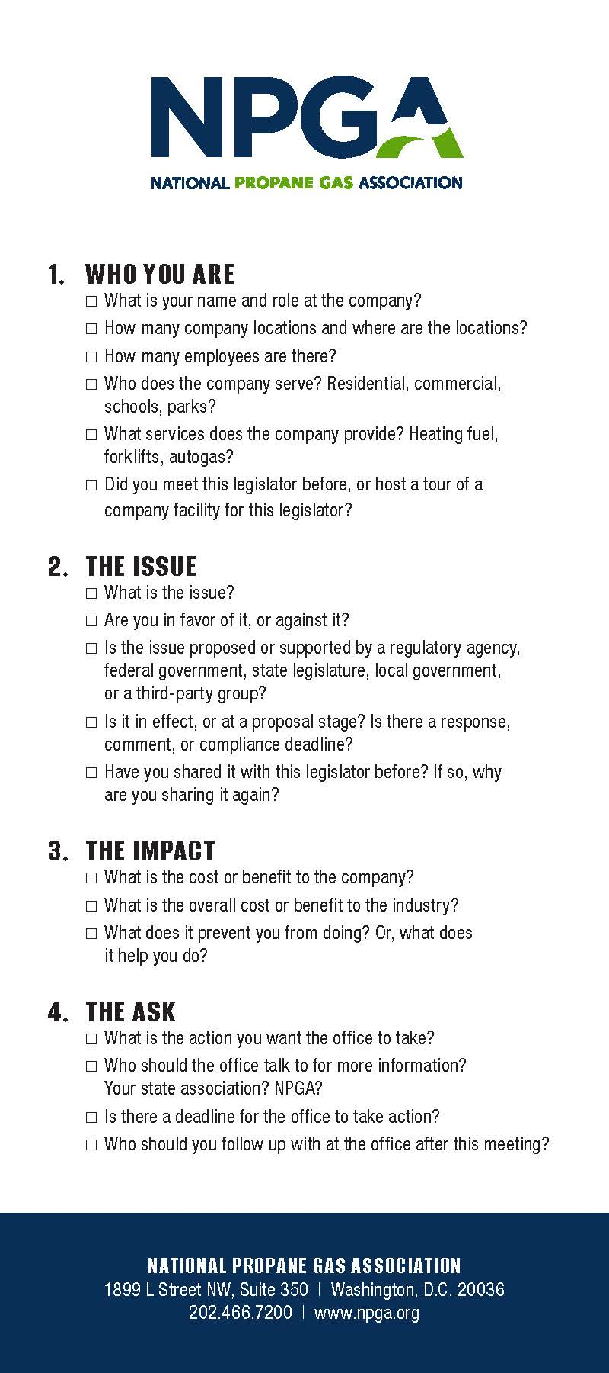
The Four Things That Make a Meeting Successful
Tell Them Who You Are
Introduce the Issue
Describe the Issue Impact
Make the Ask

Slide 14
1. Tell Them Who You Are
My name is Tyler Lawrence, and I am an employee of Baker’s Propane.
Baker’s Propane was started in 1994. We currently have one facility, which is located in Warwick, IN. We have 12 employees, which services your constituents.
The company primarily provides heating fuel for residential customers in the region.
I met with Congressman Jones during last year’s Propane Days. We also go to the same church.

Slide 15
2. Introduce the Issue
I am here today to talk to you about the propane industry’s concerns with the Jones Act.
The Jones Act is a Federal law that regulates maritime commerce, requiring goods shipped between U.S. ports to be transported on ships that are built, owned, and operated by United States citizens or permanent residents.
As we discussed last year during Propane Days, I am against the Jones Act and the burdens it places on my business and the industry.

Slide 16
3. Describe the Issue Impact
Extended cold weather can cause demand to soar which stresses propane delivery infrastructure.
These dramatic yet unnecessary supply disruptions risk shortages for consumers in winter.
The best example is the Polar Vortex of 2013-14
American customers had to wait for delayed shipments from Norway, Sweden, and Malta, whereas a Jones Act waiver would have allowed them to be served much more efficiently by American propane sources.
Shipping American propane from U.S. port to another located in New England would be the most efficient method, but there are no Jones Act compliant vessels.

Slide 17
4. Make the Ask
Provide a permanent waiver of the Jones Act for LPG to provide efficient supply to critical parts of the United States and ensure domestically produced propane is accessible.

Slide 18
Thank You for Participating! Questions? Contact Tyler Lawrence at tlawrence@npga.org.

